Slide 1
Boa Noite!
Vamos iniciar às 19:30.
Caso você não tenha uma conta da Microsoft, crie uma: account.microsoft.com
Todas as tarefas podem ser feitas diretas do navegador. O material se encontra abaixo.
https://github.com/microsoft/Reactors/tree/main/workshop-resources/data-science-and-machine-learning/Data_Science_2

Slide 2

Introdução à Ciência de Dados para Desenvolvedores Python
02/09/2020
Microsoft Reactor | São Paulo

Slide 3
Flavio Figueiredo
Professor
Universidade Federal de Minas Gerais
@flaviovdf

Slide 4


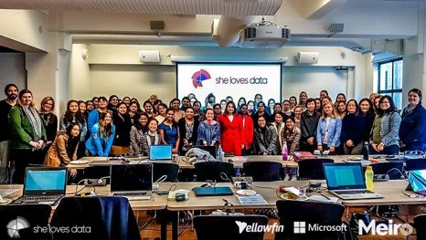

developer.microsoft.com/reactor/
@MSFTReactor no Twitter
Notes:
Welcome to your <location> Microsoft Reactors. We are worldwide local community spaces where developers and startup leaders meet, learn, and connect. Reactors build a diverse community by providing training, learning paths, industry speakers, and seminars, plus meetups and other community events related to emerging technology trends.
Reactor learning, networking, and leadership opportunities are designed to focus on real-world challenges to enable members of the tech community to stay up to date and drive solutions. Reactors are a place to share knowledge and expand impact in the company of technology enthusiasts locally and globally.
We have workshops and other learning opportunities planned throughout the year. Or if you want to host your own event at a Reactor, you can make the request on our website.

Slide 5
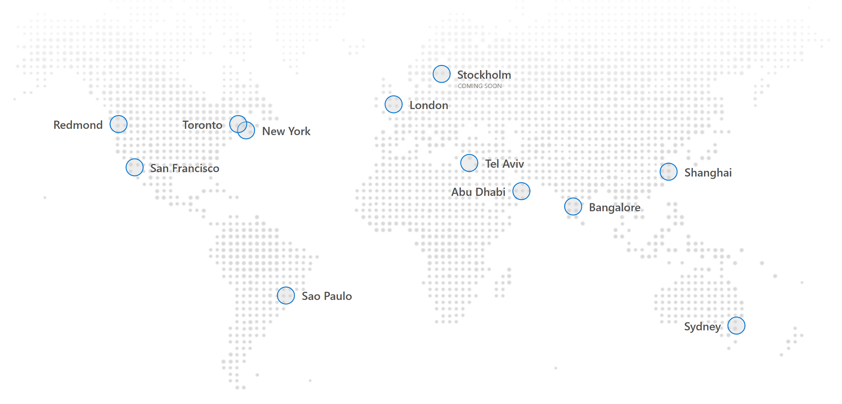
Mapa

Slide 6
Agenda de Hoje
Introdução à Ciência de Dados
Limpando e Manipulando Dados
Intervalo
Modelos de Aprendizado de Máquina
Uso de serviços na nuvem como o Azure ML Studio

Slide 7


Notes:
Data defines the world around us. The combination of mountains of data and computing that is both powerful enough and economical enough to make sense of that data has led to huge breakthroughs in science, medicine, and the consumer technologies that we now take for granted. But for all the advances that the data revolution has made, it is still held back by a resource shortage: people; specifically, people with technical skills in data science who can navigate this growing field and help explain discoveries in it to others.
For example, we might be able to:
- Assist doctors with detecting tumors on an MRI scan that might otherwise be too small to be noticed at first
- Help farmers increase their crop yields and use fewer resources like water and fertilizer
- Help a person who is blind identify people or obstacles in front of them
- Reduce defects in the manufacturing process
The video we watched shows the power and affordability of big data processing on cloud platforms like Azure. DNA sequencing analysis is a form of life-sciences research that has the potential to lead to a wide range of medical and pharmaceutical breakthroughs. However, this type of analysis requires supercomputing resources and big data storage, which many researchers have lacked before now. Working through a grant provided by the National Science Foundation in partnership with Microsoft, a team of computer scientists at Virginia Tech addressed this challenge by developing an on-demand, cloud-computing model using data & analytics services. By moving to an on-demand cloud computing model, researchers now have easier, more cost-effective access to DNA sequencing tools and resources, which could lead to even faster, more exciting advancements in medical research.
This workshop is about bridging the shortage of practitioners with technical skills in data, particularly in data science. Everyone should care about data science; you are here today because you are choosing to act to gain more information and skills in this vital, rapidly growing field. This course will give you a broad overview of many of the fundamental skills in data science using two of the most ubiquitous tools of the data trade: the Python programming language and the Jupyter Notebook interface. This course will give you a basic grounding in data science and some practical tools for performing it; these outcomes will provide you with the foundation from which to acquire deeper skills in this field, such as through the Microsoft certification for data science.

Slide 8
O que é ciência de dados?
Experiência de Domínio
Ciência
Dados
Estatística
Codificação
Notes:
Data science is gaining momentum because of 3 advancements in computing:
Ubiquity of data: Our devices and sensors are capable of creating terabytes worth of data every day.
Access to nearly limitless compute power, available to anyone with an internet connection.
Powerful algorithms that help us unlock more insight than ever from the data we have.
(feel free to elaborate on the above with examples, hold up your phone or Apple Watch for examples of consumer solutions)
Data science itself is not a new field. Statisticians like to say that data science is statistics rebranded. Some say its statistics at scale for big data.
We would suggest that (modern) data science sits at the intersection of 3 primary skills:
It has a foundation in statistics with well-established math community and generally-accepted techniques like statistical significance and linear regression.
Sophisticated data science requires people with coding experience to prepare data and build models that scale with accuracy.
But often overlooked (and arguably most importantly), data requires domain expertise--to begin with research questions, to sport inaccuracies in the data set, to know what you’re looking for, to interpret the results, and to communicate them.
Anyone can contribute to data science–whether you’re a statistician, software engineer, business leader, or the foremost authority on butterfly migration patterns (natural scientist).

Slide 9
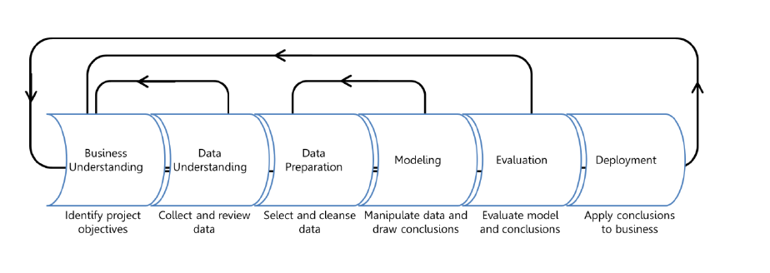
Ciência de Dados: O Processo
O principal objetivo é na extração de valor de grandes quantidades de dados. Tal extração é interpretada por humanos!
Domain Expertise
Data
Science
Code/Computing Expertise
Math/Statistics
De Introduction to Data Science: https://docs.microsoft.com/learn/modules/intro-to-data-science-in-azure/2-data-science-process
Material de apoio: https://docs.microsoft.com/en-us/azure/machine-learning/studio/data-science-for-beginners-the-5-questions-data-science-answers
Notes:
So before we start experimenting with code and data science techniques, it’s important to begin with a conceptual understanding of how data science often works. We begin by…
1. Understanding the Business Problem
In any problem-solving method, the problem must first be identified. This can either be in the form of a question or a statement. In each situation, there is always a general business understanding that will motivate the data science process.
In our example, your company understands they could be selling more brooms if they knew how many they could expect to sell each month and then stock their shelves accordingly.
2. Understanding and Preparing the Data
Data understanding comes from the process of acquiring and exploring available data. This step involves obtaining and preparing the data to be used in model training. To train models, it's important to understand the data. Data scientists start by performing exploratory data analysis (EDA) to better understand the data with which they are working, and identifying which data elements drive the outcome they want to predict. With this understanding, we can cleanse the data and extract the features required for modeling.
Your company gives their data to the data science team. The data engineer cleans and preps the data so that it's ready for the modeling process. EDA helps you learn about the relationship among data elements, which helps determine which data (or features) you will need to train the model. For example, it might help to know what people most frequently buy with brooms.
3. Modeling the Data
The modeling step is a cycle of steps that occur to improve results. Modeling can consist of several techniques, but typically one cycle iteration is not enough to produce good results, so the cycle is repeated until the desired results are achieved.
You use the available data and move into modeling and feature engineering. For this type of question where there are many different numerical variables, you try a time series model and evaluate its performance.
4. Deploying
This step is usually left to the developers. It consists of integrating the solution into the business to solve the original problem. For your company, deployment would mean using the prediction of broom sales to properly stock the shelves.
Summary
Data science is a data-driven process that starts with a question. Data acquisition and understanding then drives the modeling. The steps a data scientist usually focuses on are data understanding and modeling, which is where the results are produced. After that, the developer implements the results to test the performance.

Slide 10
Papéis especializados em Ciência de Dados
Analista de Negócios Engenheiro de Dados Cientista de Dados
Arquiteto de Dados Desenvolvedor
Ênfase de domínio
Ênfase técnica
Notes:
The data science process is often completed by a team of people with different roles:
Business Analyst or Domain Expert
The business analyst or domain expert provide the deep business understanding to accurately guide the project. They understand the functional area and data. Some of the tools they use include but are not limited to:
Microsoft Excel with statistics functions
Query tools such as SQL
Power BI
Data Engineer
The data engineer prepares the data for use by the data scientist in model training. This step, known as data wrangling, cleans and transforms the data.
Common tools the data engineer will use include but are not limited to:
SQL Server and SQL Data Warehouse
Extraction, transformation, and loading (ETL) tools
Azure Data Lake
Azure IoT Hub and Stream Analytics
Azure Databricks or HDInsight using Hadoop or Spark
R
Python
Developer
The developer is responsible for model deployment, and potentially development of the application that will use the model to score new data. This means the developer builds out the platform or the method for the model consumption and integration into the business--possibly both.
Common tools the developer will use include but are not limited to:
Python
C#, Java, or JavaScript
Web development
Source code control (Git, Svn)
Data Scientist
The data scientist is responsible for understanding the data, then training and testing the model. They will likely also be involved with the other roles as they are at the heart of the process.
Common tools the data scientist will use include but are not limited to:
Python and related packages
R and related packages
Azure Machine Learning Services

Slide 11


Mediana do salário base (USA):
$130,000
Cientista de Dados
#1 in 2018 and 2019
https://blog.linkedin.com/2019/january/10/linkedins-most-promising-jobs-of-2019
Notes:
If you’re a beginner or an industry professional looking to upskill into data science, there’s no better time than now. A data scientist continues to be the #1 most promising job role according to LinkedIn in both 2018 and 2019.

Slide 12
Vamos clonar o Notebook do nosso workshop
https://github.com/microsoft/Reactors/tree/main/workshop-resources/data-science-and-machine-learning/Data_Science_2

Slide 13
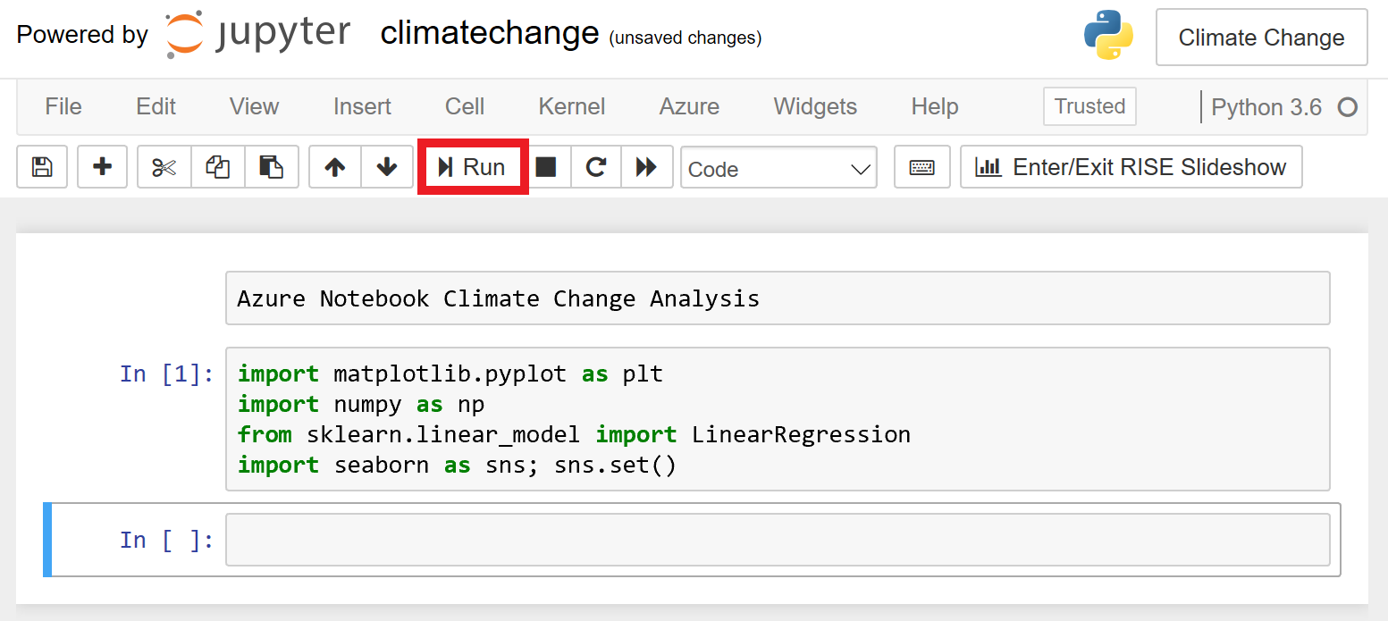
Como navegar em Notebooks Azure
https://docs.microsoft.com/en-us/learn/modules/analyze-climate-data-with-azure-notebooks/1-create-an-azure-notebook
Notes:
Azure Notebooks is a cloud-based platform for building and running Jupyter Notebooks. Jupyter is an environment based on IPython that facilitates interactive programming and data analysis using a variety of programming languages, including Python. Jupyter Notebooks enjoy widespread use in research and academia for mathematical modeling, machine learning, statistical analysis, and for teaching and learning how to code.
Azure Notebooks provide Jupyter as a free service. It's a convenient way to build notebooks and share them with others without having to install and manage a Jupyter server. And it's web-based, making it an ideal solution for collaborating online. In this lab, you will create an Azure Notebook and use three popular Python libraries — scikit-learn, NumPy, and Seaborn — to analyze your data. Then you will share the notebook so others can experiment with it too.

Slide 14
Manipulação e limpeza de dados

Slide 15


Cerca de 80% do tempo do projeto geralmente é gasto limpando e preparando dados para a análise
Notes:
A widely-accepted rule of thumb in data science is that about 80 percent of every project will be spent cleaning and preparing data for the actual analysis. For this reason, it is vital to master these skills, no matter what one does in data science.
Why practice “data munging?”
Both science…and art
Essential to high-quality insights/outcomes

Slide 16
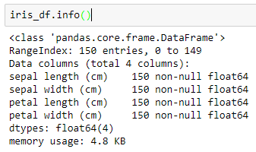
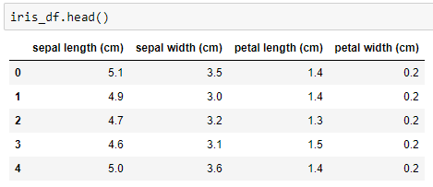
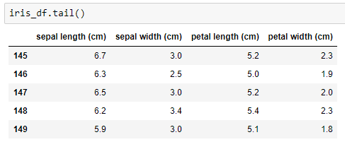
Explorando informações do DataFrame
DataFrame.info
DataFrame.head
DataFrame.tail
Notes:
DataFrame.info lists the columns and number of entries.
DataFrame.head returns the first five rows of a DataFrame (by default).
DataFrame.tail returns the last five rows of a DataFrame.

Slide 17
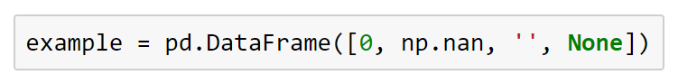
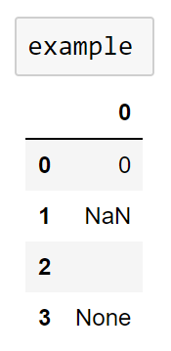
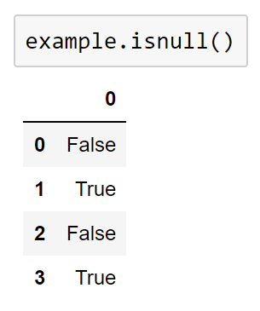
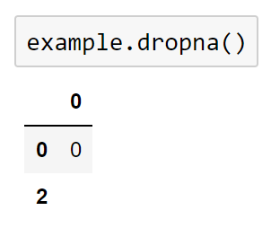
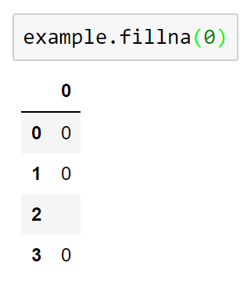
Lidando com dados ausentes
Python null → None
NumPy/pandas null → NaN
Notes:
Dealing with Missing data
Most of the time, the datasets you want to use (or have to use) have missing values in them. How missing data is handled carries with it subtle tradeoffs that can affect your final analysis and real-world outcomes.
Pandas handles missing values in two ways. The first you've seen before in previous sections: NaN, or Not a Number. This is actually a special value that is part of the IEEE floating-point specification, and it is only used to indicate missing floating-point values.
For missing values apart from floats, pandas uses the Python None object. While it might seem confusing that you will encounter two different kinds of values that say essentially the same thing, there are sound programmatic reasons for this design choice and, in practice, going this route enables pandas to deliver a good compromise for the majority of cases. Notwithstanding this, both None and NaN carry restrictions that you need to be mindful of with regards to how they can be used.
None: Non-Float Missing Data
Because None comes from Python, it cannot be used in NumPy and pandas arrays that are not of data type “object”. Remember, NumPy arrays (and the data structures in pandas) can contain only one type of data. This is what gives them their tremendous power for large-scale data and computational work, but it also limits their flexibility. Such arrays have to upcast to the “lowest common denominator,” the data type that will encompass everything in the array. When None is in the array, it means you are working with Python objects.
NaN: Missing Float Values
In contrast to None, NumPy (and therefore pandas) supports NaN for its fast, vectorized operations and ufuncs. The bad news is that any arithmetic performed on NaN always results in NaN.
NaN and None: Null Values in pandas
Even though NaN and None can behave somewhat differently, pandas is nevertheless built to handle them interchangeably.
Detecting Null Values
Both isnull() and notnull() are your primary methods for detecting null data. Both return Boolean masks over your data.
Dropping Null Values
Beyond identifying missing values, pandas provides a convenient means to remove null values from Series and DataFrames. (Particularly on large datasets, it is often more advisable to simply remove missing [NA] values from your analysis than deal with them in other ways).
You cannot drop a single value from a DataFrame, so you must drop full rows or columns. Depending on what you are doing, you might want to do one or the other, and so pandas gives you options for both. Because, in data science, columns generally represent variables and rows represent observations, you are more likely to drop rows of data. The default setting for dropna() is to drop all rows that contain any null values.
Filling Null Values
Depending on your dataset, it can sometimes make more sense to fill null values with valid ones rather than drop them. You could use isnull to do this in place, but that can be laborious, particularly if you have a lot of values to fill. Because this is such a common task in data science, pandas provides fillna, which returns a copy of the Series or DataFrame with the missing values replaced with one of your choosing.

Slide 18
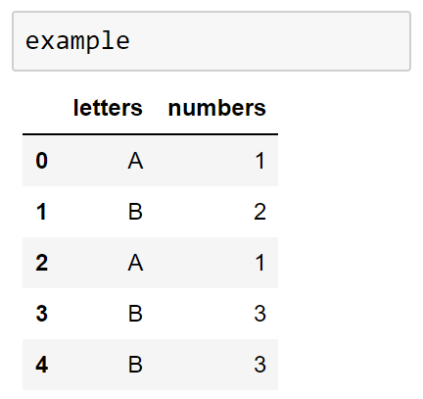
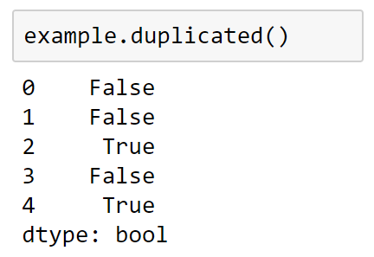
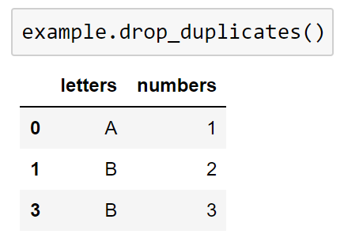
Removendo dados duplicados
Identificando duplicatas
Descartando duplicatas
Notes:
Removing Duplicate Data
In addition to missing data, you will often encounter duplicated data in real-world datasets. Fortunately, pandas provides an easy means of detecting and removing duplicate entries.
Identifying Duplicates: Duplicated
You can easily spot duplicate values using the duplicated method in pandas, which returns a Boolean mask indicating whether an entry in a DataFrame is a duplicate of an earlier one. Let's create another example DataFrame to see this in action.
Dropping Duplicates: drop_duplicates
drop_duplicates simply returns a copy of the data for which the duplicated values are False.

Slide 19
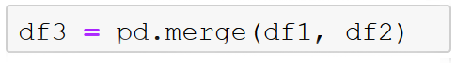
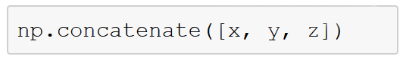
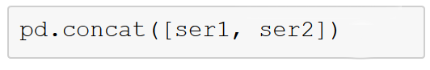
Combinando conjuntos de dados (datasets)
Tipos de Joins:
um-para-um, vários-para-um, vários-para-vários
Concatenação em NumPy:
Concatenação em Pandas:
Concatenação com Joins:
Notes:
Combining Datasets: Merge and Join
Your most interesting analyses will often come from data melded together from more than one source. Because of this, panda provides several methods of merging and joining datasets to make this necessary job easier:
pandas.merge connects rows in DataFrames based on one or more keys.
pandas.concat concatenates or “stacks” together objects along an axis.
The combine_first instance method enables you to splice together overlapping data to fill in missing values in one object with values from another.
Categories of Joins
Merge carries out several types of joins: one-to-one, many-to-one, and many-to-many. You use the same basic function call to implement all of them, and we will examine all three (because you will need all three at some point in your data delving, depending on the data). We will start with one-to-one joins because they are generally the simplest example.
Concatenation in NumPy
Concatenation in pandas is built from the concatenation functionality for NumPy arrays.
Concatenation in pandas
Pandas has a function, pd.concat(), that can be used for a simple concatenation of Series or DataFrame objects in similar manner to np.concatenate() with ndarrays.
Concatenation with Joins
Just as you did with merge above, you can use inner and outer joins when concatenating DataFrames with different sets of column names.

Slide 20
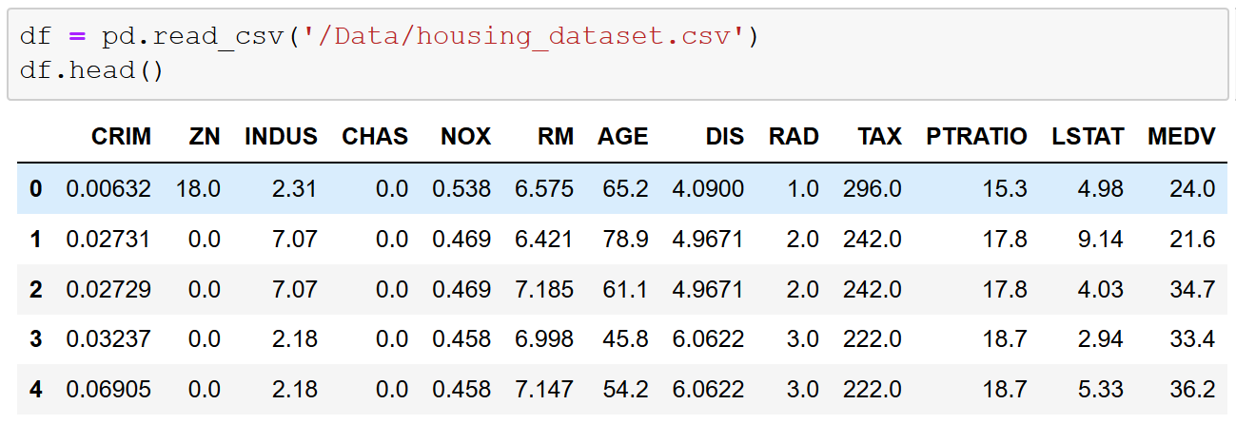
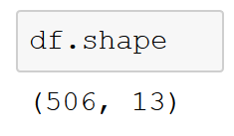
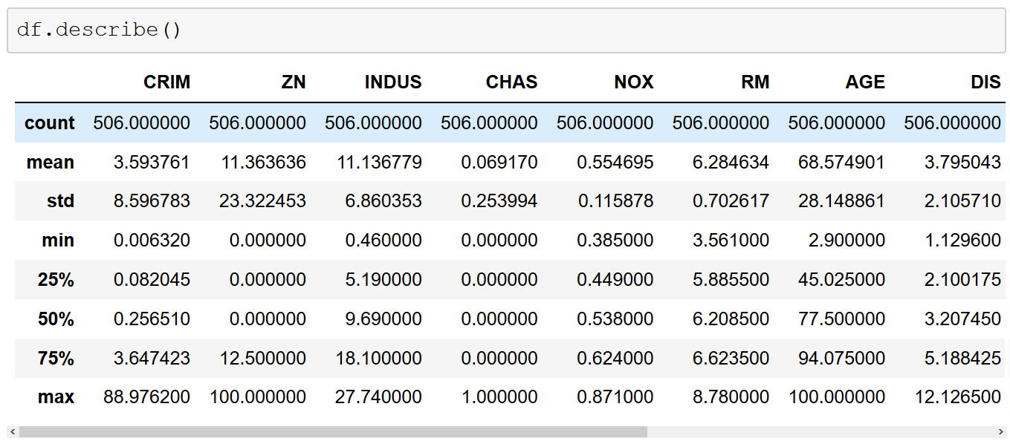
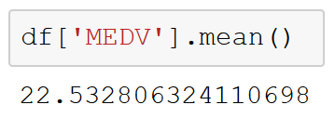
Estatística e visualização exploratória
Notes:
Exploratory Statistics and Visualization
Often, when probing a new dataset, it is invaluable to get high-level information about what the dataset holds. Earlier in this section, we discussed using methods such as DataFrame.info, DataFrame.head, and DataFrame.tail to examine some aspects of a DataFrame. While these methods are critical, they are on their own often insufficient to get enough information to know how to approach a new dataset. This is where exploratory statistics and visualizations for datasets is useful.
One of the first methods we can use to better understand this dataset is DataFrame.shape.
To get a better idea of the contents of each column, we can use DataFrame.describe, which returns the maximum value, minimum value, mean, and standard deviation of numeric values in each columns, as well as the quartiles for each column.
Note that you can also examine specific descriptive statistics for columns without having to invoke DataFrame.describe.

Slide 21
Aprendizado de Máquina

Slide 22
Machine Learning Overview
O que é aprendizado de máquina?
Onde a “magia” de ciência de dados ocorre!
Serve para automatizar tarefas de regressão e classificação.
Resultados surpreendentes na ciência e indústria.
Serviços de streaming de músicas de ponta fazem uso de bibliotecas como Scikit-Learn!
Notes:
Machine learning powers many of the remarkable results that the data revolution has produced in science, medicine, and business. It automates data extrapolation and classification. Better still, it is fun! Python has a powerful library for ML in scikit-learn, which enables those studying and performing data science to use efficient algorithms without getting mired in the details of programming those algorithms.
Generic Example
A leading music-streaming service uses scikit-learn to power its music recommendations.
Specific Example
Spotify uses scikit-learn to power its music recommendations for listeners. Per Erik Bernhardsson, Engineering Manager Music Discovery and Machine Learning at Spotify, “Scikit-learn provides a toolbox with solid implementations of a bunch of state-of-the-art models and makes it easy to plug them into existing applications. We’ve been using it quite a lot for music recommendations at Spotify, and I think it’s the most well-designed ML package I’ve seen so far.” (https://scikit-learn.org/stable/testimonials/testimonials.html).

Slide 23
Análise Preditiva e Preemptiva
Dados
Domain Expertise
O que devo fazer?
Decisões
Ações
Vai ocorrer?
Quando ocorreu?
Data
Science
Qual foi o motivo?
Processo Manual
Code/Computing Expertise
Math/Statistics
Notes:
Notes:
Data science is evolving. It began simply trying to figure out what happened in the past.
Then it began going deeper and discovering why it happened.
Then it started predicting the future and figuring out what will happen.
The final goal is to not only figure out what will happen but to make decisions preemptively and take actions automatically.
References:
Microsoft: DATA203x Data Science and Machine Learning Essentials, https://www.edx.org/

Slide 24
”O aprendizado de máquina é a ciência que permite os computadores a aprenderem sozinhos ao invés de serem programados explicitamente.”
-- Dr. Danko NIkolic
Notes:
Technically, machine learning is a method of data analysis that automates analytical model building.
But we can think of it as a technique to train artificially-intelligent systems without needing to be specifically programmed.
Instead, you create an algorithm that takes in data and uses statistics to predict an output that’s reasonably correct.
If you’ve bought something on the internet and seen “related products” for you to buy, those suggested products were almost certainly selected using a machine learning algorithm.
Or, if you’re watching a Netflix shows and it suggests other shows to check out–Netflix picked those shows using a machine learning algorithm.
Terms are often used interchangeably.
One funny and true way of remembering the difference, is that when you’re trying to sell a product, you call it AI. When you’re trying to hire someone to build the product, you call it Machine Learning.

Slide 25
Desmitificando o Aprendizado de Máquina
Age | Income | Education | Gender | Housing
61 | $65,000 | Moderate | F | Own
42 | $72,000 | High | F | Rent
18 | $25,000 | Moderate | M | Other
22 | $36,000 | Low | M | Rent
Dados de Treino
31 | $52,000 | High | M | ?
Conhecemos
(“features”, “atributos”)
Queremos Prever
(“classe”, “rótulo”)
Notes:
Okay, quick, simple example:
So, like I said, machine learning works through algorithms that take in data and use statistics to predict a reasonably correct output.
As an example, imagine you’re trying to predict whether someone rents or owns their home.
To do this, we’d need a bunch of data about all kinds of people who both rent and own homes.
In this example, we have their age, their income, their education level, gender, and of course, whether they own or rent.
… remember it in a “model”
Then, we use that model: we put in the features of the person we’re trying to guess about and the model will give us its best prediction of whether or not that person owns or rents their home.

Slide 26


Como criar um Modelo Preditivo de ML
Construir
Escolher e configurar o modelo.
Limpar os Dados
Filtrar os Dados
Treinar
Use os dados de treino para ajustar o modelo.
Testar
Teste em dados ocultos para validar o modelo.
Prever
Se o modelo for bom, use!
Notes:
ML starts with data which can come from a variety of sources. You might pull in a large static dataset like historical weather temperatures or on-time flight arrivals to predict a likely outcome like global climate change or whether your flight from Chicago will arrive on time. There are also tools to capture and stream real-time data. Say you’re in a car race and telemetry is coming in at 1GB per second. If you could build a model that could predict when a pitstop is most needed based on “features” like tire pressure, fuel, and engine temp, would that be the difference between winning or not (or at least NOT crashing the car)? ☺
Most data typically needs to be "cleaned" before it is used. Examples of cleaning include removing rows with missing data, replacing missing data algorithmically, removing duplicate rows, and removing rows containing "outliers“. Data scientists will also perform “feature selection” or more advanced, math-intensive “feature engineering”--in which you’re optimizing your dataset to maximize its training potential. In practice, all of this can be very time-intensive and often consumes 50-80% of the time required to build the model.
Once the data is ready, you select an algorithm and "train" the model by allowing it to iterate over the data and find patterns. After that comes scoring and evaluating the model, which tells you how well the model can predict outcomes. Machine Learning is a trial and error process but fortunately there are some amazing open source tools and libraries to help you. You might have heard the term “deep learning”--this often refers to specific algorithms that can be used with popular frameworks like Keras, Tensorflow, and CNTK. When building ground-breaking predictive models with huge datasets, that’s also where the compute potential and flexibility of a cloud platform like Azure comes in.

Slide 27
Tipos de Aprendizado de Máquina
Supervisionado
Não Supervisionado
Uso de rótulos para:
Aprender de um conjunto de treino
Mapeamento de atributos para rótulos
Aprendizado sem rótulos
Padrões e agrupamentos
Exemplos:
Clusterização
Recomendação
Notes:
Machine learning models fall into two broad categories: supervised and unsupervised.
In supervised learning, the model is "trained" with a large volume of data and algorithms are then used to predict an outcome from future inputs. Most supervised learning models use regression algorithms to compute an outcome from a continuous set of possible outcomes (for example, your score on a test), or classification algorithms to compute the probability of an outcome from a finite set of possible outcomes (for example, the probability that an e-mail is spam or a credit-card transaction is fraudulent).
In unsupervised learning, the computer isn't trained, but is presented with a set of data and challenged to find relationships in it. K-Means Clustering is a common unsupervised learning algorithm. For a great explanation of how it works, see https://www.intercom.com/blog/machine-learning-way-easier-than-it-looks.

Slide 28
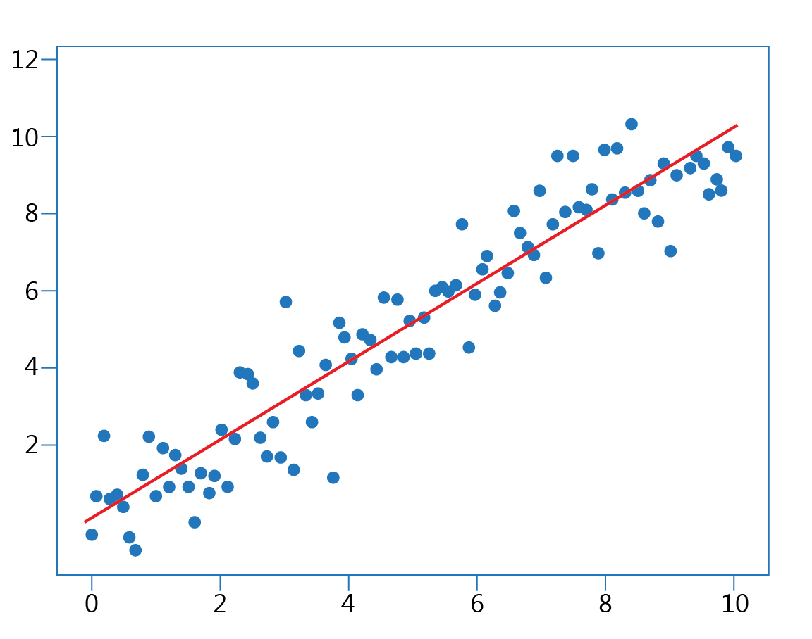
Previsão: Regressão Linear
“Desenhe a Curva”
Extrapola dados usando pontos existentes
Exemplo: U.S. Housing dataset
Notes:
Arguably the simplest form of ML is to draw a line connecting two points and make predictions about where that trend might lead. But what if you have more than two points—and those points don't line up neatly? What if you have points in more than two dimensions? This is where linear regression comes in.
Formally, linear regression is used to predict a quantitative response (the values on a Y axis) that is dependent on one or more predictors (values on one or more axes that are orthogonal, or less linear). The goal of linear regression is to fit a straight line in the best possible way to minimize the deviation between our observed responses in the dataset and the responses predicted by our line, the linear approximation. (The most common means of assessing this error is called the least squares method. It consists of minimizing the number you get when you square the difference between your predicted value and the actual value and add up those squared differences for your entire dataset).
(Y, commonly thought of collectively as X). The working assumption is that the relationship between predictors and response is more

Slide 29
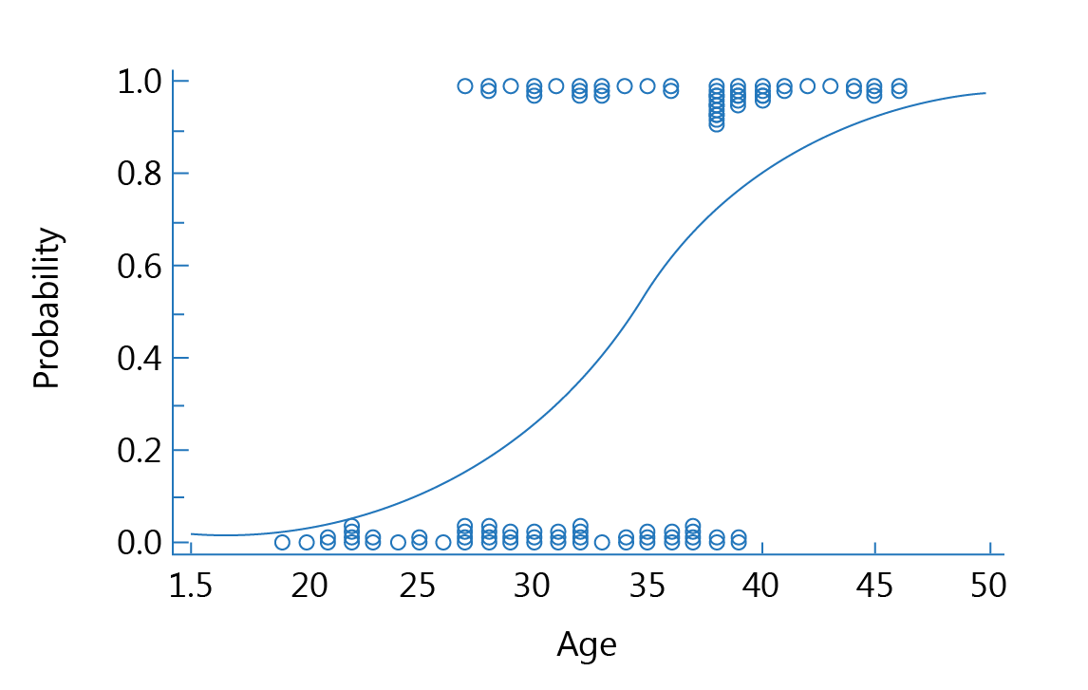
Classificação: Regressão Logística
Classificação Binária
Ajuste uma Curva-S entre 0 and 1
0 implica em falso
1 em verdadeiro
Examplo: Titanic dataset
Notes:
Classification: Logistic Regression
If our simple analogy of predictive analytics was drawing a line through points and extrapolating from that, then classification can be described in its simplest form as drawing lines around groups of points.
While linear regression is used to predict quantitative responses, logistic regression is used for classification problems. Formally, logistic regression predicts the categorical response (Y) based on predictors (Xs). Logistic regression goes by several names, and it is also known in the scholarly literature as logit regression, maximum-entropy classification (MaxEnt), and the log-linear classifier.
In this algorithm, the probabilities describing the possible outcomes of a single trial are modeled using a sigmoid (S-curve) function. Sigmoid functions take any value and transform it to be between 0 and 1, which can be used as a probability for a class to be predicted, with the goal of predictors mapping to 1 when something belongs in the class and 0 when they do not.

Slide 30
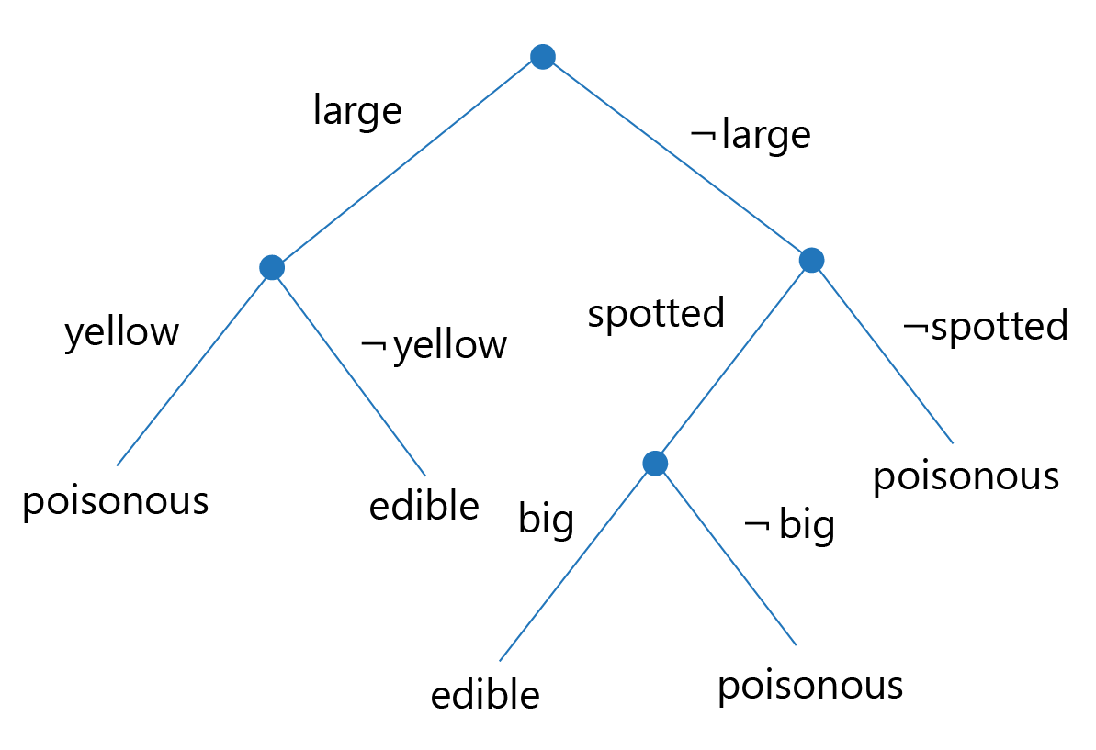
Classificação: Regressão Logística
Classificação Binária
Verdadeiro ou Falso em cada Nó
Modelo de fácil interpretação por humanos
Notes:
Classification: Decision Trees
If logistic regression uses observations about variables to swing a metaphorical needle between 0 and 1, classification based on decision trees programmatically builds a Yes/No decision to classify items.

Slide 31
Aprendizado de Máquina na Nuvem

Slide 32
Aprendizado de Máquina na Nuvem
Qual o motivo de fazer uso da nuvem?
Acesso rápido e barato ao estado-da-arte
Implemente e faça deploy de serviços REST que executam ações de aprendizado de máquina
O Cincinnati Children's Hospital faz uso do Azure Cognitive Services para o entendimento de linguagem natural.
Notes:
Deploying trained and tuned models to the cloud makes those models ready for repeated use anywhere on the internet. In this section, we will examine how to do this with models that you train.
In addition, we will also look at trained models provided by third parties such as Microsoft Azure. To get a sense of why using cloud-based models can be compelling, consider Cincinnati Children's Hospital, which uses Azure Cognitive Services Language Understanding for natural-language interaction in its Caren app for parents of children in the hospital (https://customers.microsoft.com/en-us/story/cincinnati-childrens-hospital-health-provider-azure). Using natural-language processing based in the cloud enabled Cincinnati Children’s to quickly and affordably develop its Caren app while providing a good user experience for parents.

Slide 33
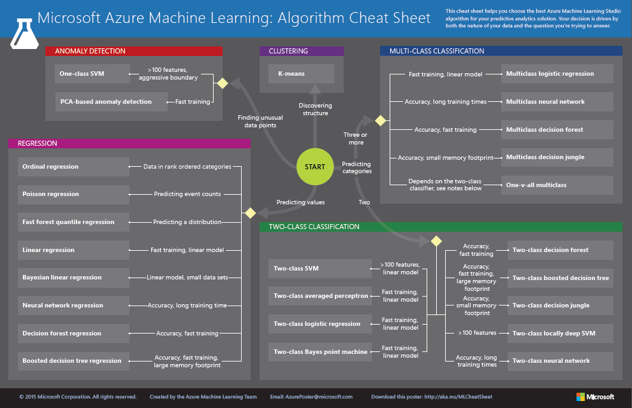
http://aka.ms/MLCheatSheet
Notes:
The Azure ML Cheat Sheet helps you pick the right algorithm for a model, even if you're not a trained data scientist. One example is if you want to use a set of input values to predict an output value from a continuous set of values (e.g., a person's age), use linear regression. But if you're more interested in the distribution of the output, you might use fast forest quantile regression instead. An example of when you would use the latter is using growth charts to assess child development. "Abby's height is in the 10% quantile of the heights of kids her age”. Classification algorithms, by contrast, are used to predict a value from a discrete set of values--for example, classifying an e-mail as spam or not spam.

Slide 34
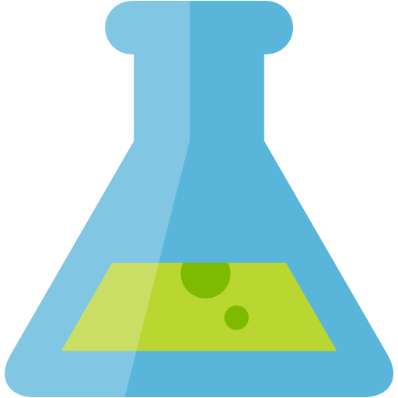







Exemplo de uma Arquitetura na Nuvem
Aprendizado de Máquina Azure (predições em tempo real)
Dados,
Estatísticas,
Anomalias,
Filtros e Agregações em Tempo Real
Sensores
Telemetria
Hub de Eventos Azure
Analytics em Tempo Real Azure (Streams)
Power BI
Dashboard
Previsões e Eventos em Tempo Real
Azure SQL Data Warehouse
Notes:
Here’s an example of a data science solution built on Azure. Let’s say you’re manufacturing new cars. The solution helps predict failures on the assembly line by analyzing sensors in which a robot failed to assemble a piece as expected. It might warn a QA inspector to repair the robot before too many cars produce a defect. If you think about how expensive it is for a car manufacturer to recall and install new parts (not to mention the safety risks), this is a game changer.
We design this in Azure by connecting a few services together:
Event Hubs ingests raw assembly-line data and passes it on to Stream Analytics.
Stream Analytics provides near real-time analytics on the input stream from the Azure Event Hub. Input data is filtered and passed to a machine learning endpoint, finally sending the results to the Power BI dashboard.
Machine Learning functions written in Azure predict potential failures based on real-time assembly-line data from Stream Analytics.
A SQL Data Warehouse based in Azure stores assembly-line data along with failure predictions.
Power BI visualizes real-time assembly-line data from Stream Analytics and the predicted failures and alerts from Data Warehouse.
(Source: https://docs.microsoft.com/en-us/azure/architecture/solution-ideas/articles/defect-prevention-with-predictive-maintenance)

Slide 35
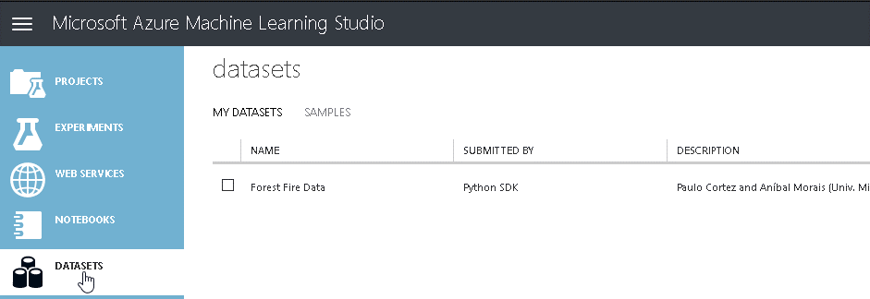
Azure Machine Learning Studio
Crie e conecte-se a um ambiente Azure ML Studio
Explore os dados (Portugal forest fire data)
Transfira seus dados para o Azure Machine Learning Studio
Crie seu Modelo
Faça o Deploy do seu Modelo
Consuma o Serviço Web
Notes:
Thus far, we have looked at building and fitting ML models “locally”. True, the notebooks have been located in the cloud themselves, but the models with all of their predictive and classification power are stuck in those notebooks. To use these models, you would have to load data into your notebooks and get the results there.
In practice, we want those models accessible from many locations. And while the management of production ML models has a lifecycle of its own, one part of that is making models accessible from the web. One way to do so is to develop them using third-party cloud tools, such as Microsoft Azure Machine Learning Studio.
Alternatively, we can develop and deploy a function that can be accessed by other programs over the web—a web service—that runs within Azure Machine Learning Studio and do so entirely from a Python notebook.

Slide 36
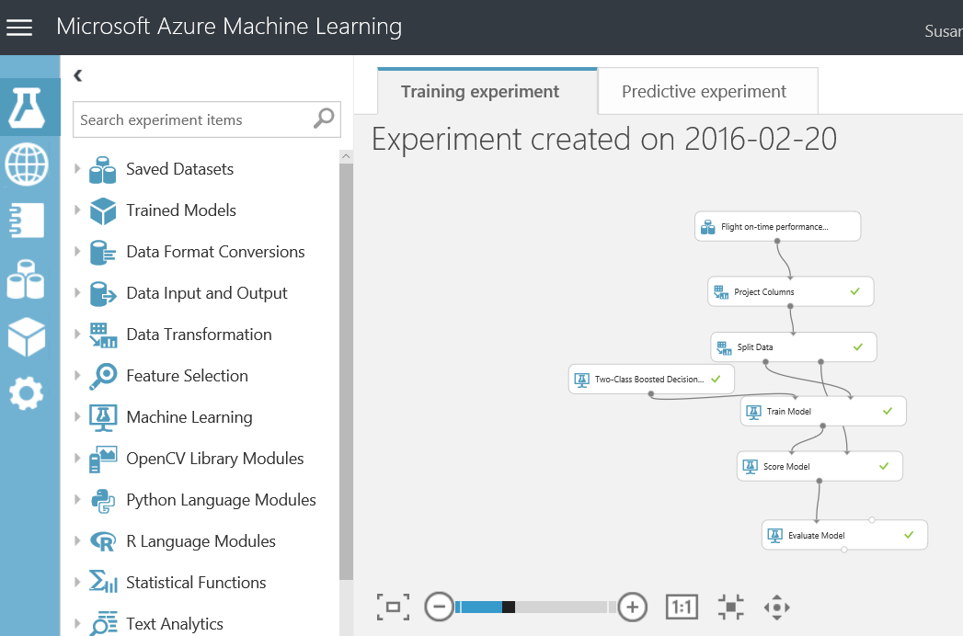
O ML Studio é ideal para protótipos!
Notes:
You’ve learned a lot about Python that you can use in ML Studio. But let’s say you don’t want to write Python or you want to explore concepts in data science that might not yet be in your Python toolbox. ML Studio dramatically reduces the effort and expertise required to create machine learning models. Rather than write reams of code to clean the data, implement a learning algorithm, and assess the results, you create "workflows" by assembling modules on a canvas. ML Studio includes more than 100 different modules that perform common tasks such as removing duplicate rows or cleaning rows with missing data, and that implement common machine learning algorithms (25 of them, to be exact). There is even a module named Tune Model Hyperparameters that will find the optimum settings for the learning algorithm you choose. And if there's not a module to perform the task you want, you can always use an Execute R Script or Execute Python Script module to inject code of your own.

Slide 37
Recursos Adicionais de Aprendizado

Slide 38
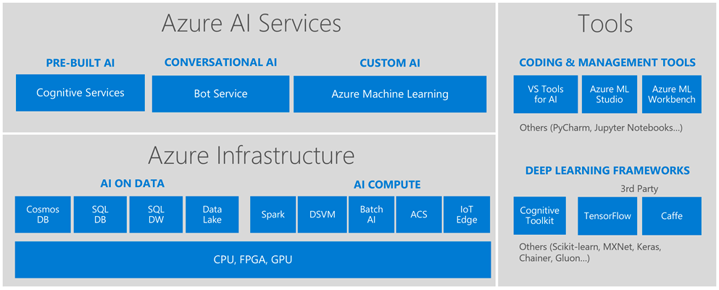
Microsoft AI Platform
Azure Notebooks
PyTorch
Sci-kit Learn
https://docs.microsoft.com/learn/modules/choose-data-science-option-in-azure/2-ml-options-on-azure
Notes:
So we’ve learned about pre-built AI but what happens when you’ve gotten to the point where you want to build your own models? Turns out that Microsoft has already many of those “building blocks” too because that’s how we build intelligence into our own products like Cortana, Office, Windows, and XBOX.
//you’re recapping this first part to reinforce the highest priority concepts. This is the most important part for student developers.
And you don’t have to be an expert coder to start building with it:
AI Services: Use these high-level “finished” services to add intelligence to your apps. In addition to computer vision, speech, and language, we also have our own Bot service.
AI Tools: If you want to start exploring training your own machine learning models but don’t have a lot of coding experience, try the Azure Machine Learning Studio, the drag and drop tool for training and deploying predictive models. It also supports custom Python and R coding modules.
But maybe you have already started learning python Pandas and tools like Sci kit learn to train your own models.
AI Infrastructure:
Tools like Azure Data Lake allow you to access data from multiple data sources to train your models. You might already be familiar with the basics for databases through SQL Server or Blob storage.
The Data Science Virtual Machine saves you time with pre-installed tools (more on that later).
AI Tools:
Azure ML Workbench allows you to write your own Python code to train models.
Azure Notebooks is the Azure implementation of Jupyter Notebooks.
Or maybe you’re ready to build your own models and algorithms on “bare metal” infrastructure.
AI Infrastructure:
Open source tools like Apache spark are supported on Azure.
Batch AI allows you to train models on clusters of virtual machines.
Azure Container Service can help you manage your Kubernetes environment.
AI Tools:
Azure supports open source frameworks like Tensorflow and Caffe where you can use neutral networks to train your models.
Keras in another good solution for rapid prototyping.
Cognitive Toolkit is Microsoft’s own framework for deep learning which is designed for the largest datasets with performance in mind.
//optional: share your personal favorite or recent project on which you’ve worked.

Slide 39
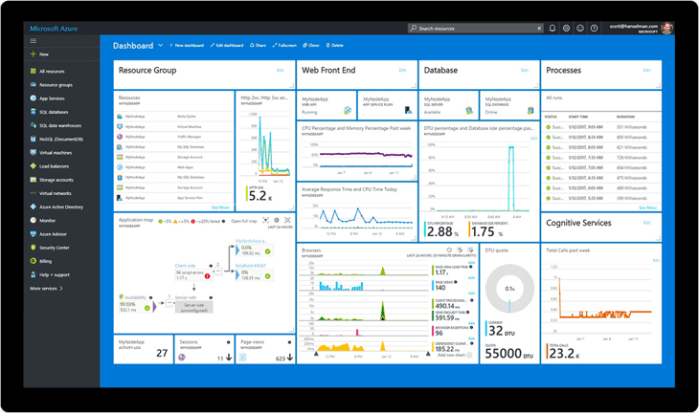
Azure Gratuíto Para seu Próximo Experimento!
azure.microsoft.com/free/azure.microsoft.com/free/students/
Notes:
https://azure.microsoft.com/free/
Pros: $200 for 30 days + Always Free tier
https://azure.microsoft.com/free/students/
Students: $100 for 12 months + Always Free tier

Slide 40
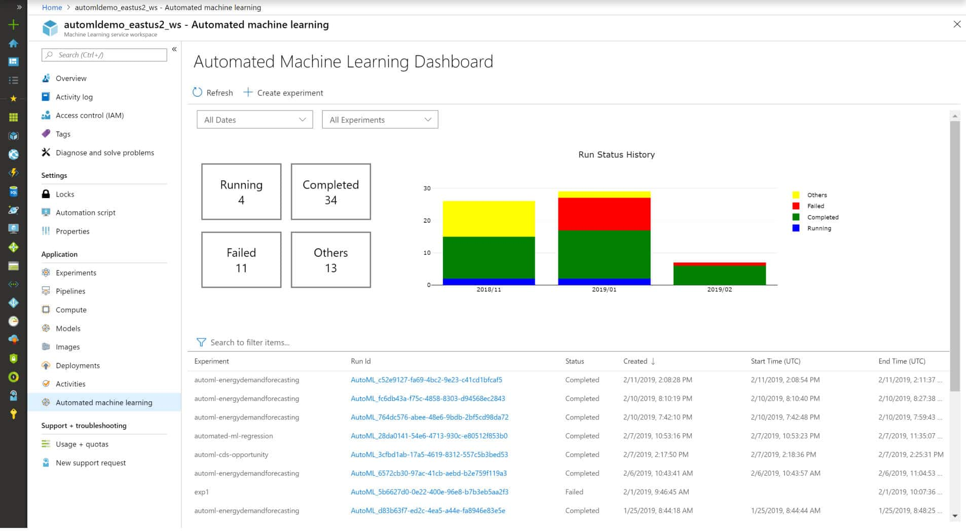
Serviços de Aprendizado de Máquina Azure
Notes:
Simplified machine learning with powerful, no-code, automated machine learning capabilities and open-source support.
Robust DevOps for machine learning that integrates with your existing DevOps processes and helps manage the complete machine learning lifecycle.
Scale on demand from your desktop, and build and deploy machine learning models anywhere, from cloud to edge.
Enterprise-ready Azure security, control, and governance to help protect your infrastructure and capabilities.
Rapidly build and deploy machine learning models using tools that meet your needs across skill levels, from no-code to code-first experiences. Use a visual drag-and-drop interface, a hosted notebook environment, or automated machine learning. Accelerate model development with automated feature engineering, algorithm selection, and hyperparameter sweeping. Get built-in support for familiar open-source tools and frameworks, including ONNX, Python, PyTorch, scikit-learn, and TensorFlow.

Slide 41
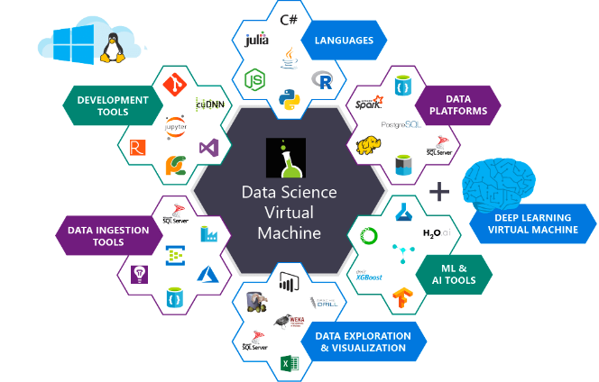
Máquinas Virtuais de Aprendizado de Máquina
Notes:
If you want to build your own solutions, you have an ultimate companion in the Data Science Virtual Machine:
It provides all the big data, data analytics, and machine learning tools you need in one pre-configured, ready-to-use environment, which you can automatically spin up in Azure in one of two Linux versions or in a Windows version if you prefer.
You can choose many different sizes and configurations–some have GPUs or CPU/RAM configuration that are optimized for specific types of deep learning tasks like Image Recognition.
Visual Studio and the Azure SDK comes pre-installed along with language packs so you can use what you know–R, Python, SQL, and C#.
[Complete list of what’s on the DSVM below:]
Azure Machine Learning Workbench
Microsoft ML Server Developer Edition
Anaconda Python distribution
Microsoft R Server 9.2.1 with Microsoft R Open 3.4.1, MicrosoftML package with machine learning algorithms, RevoScaleR and revoscalepy for distributed and remote computing, and R and Python Operationalization
Jupyter Notebook (with R, Python, PySpark kernels)
Visual Studio Code, IntelliJ IDEA, PyCharm, and Atom
Power BI desktop
SQL Server 2017 Developer Edition
Single node local Hadoop
Standalone Spark instance for local development and testing
Azure command-line interface
H2O, Deep Water, and Sparkling Water
JuliaPro
Intel Math Kernel Library
xgboost for gradient boosting
Machine Learning and Data Analytics Tools:
Deep Learning Frameworks: A rich set of AI frameworks including Microsoft Cognitive Toolkit, TensorFlow, Chainer, Apache MXNet, Keras are included on the VM.
Vowpal Wabbit: A fast machine learning system supporting techniques such as online, hashing, Allreduce, reductions, learning2search, active, and interactive learning.
XGBoost: A tool providing fast and accurate boosted tree implementation.
Rattle (the R Analytical Tool To Learn Easily): A tool that makes getting started with data analytics and machine learning in R easy, with GUI-based data exploration and modeling with automatic R code generation.
Weka : A visual data mining and machine learning software in Java.
Apache Drill: A schema-free SQL Query Engine for Hadoop, NoSQL and Cloud Storage. Supports ODBC and JDBC interfaces to enable querying NoSQL and files from standard BI tools like Power BI, Excel, Tableau.
Libraries in R and Python for use in Azure Machine Learning and other Azure services
Git including Git Bash to work with source code repositories including GitHub, Visual Studio Team Services.
Windows ports of several popular Linux command-line utilities (including awk, sed, perl, grep, find, wget, curl etc) accessible through command prompt.
Data Science Virtual Machine page.
Other Versions of the Data Science Virtual Machine
An Ubuntu image is available as well, with many similar tools plus a few additional deep learning frameworks. A CentOS image is also available. We also offer a Windows Server 2012 edition of the data science virtual machine though a few tools are only available on the Windows Server 2016 edition. Otherwise, this article also applies to the Windows Server 2012 edition.

Slide 42






Azure Cognitive Services (pronto para uso, modelos já treinados)
Decisão
Construa APPs que se baseiam em recomendações para tomadas de decisões
Visão
Entendimento de imagens cobrindo detecção de objetos, faces e sentimentos
Fala
Entenda a fala natural dos seus usuários com serviços de transcrição e sentimento
Lingua
Processe textos para entender as necessidades de seus usuários
Conhecimento
Ontologias e Bases de Dados WEB para aprimorar o conhecimento de seus APPs
Busca
Faça uso da API Bing para ter acesso a resultados de busca na WEB
Notes:
//Speakers: you can skip this slide if you prefer to demo a series of more code-first Cognitive Services demos. Here are the ones we recommend:
Shana Matthews keeps a list of notebook-based demos here: https://github.com/shanamatthews/hackathons/tree/master/hackmit/cogservices_demos
Use the web-based demos in-browser:
Computer Vision: https://azure.microsoft.com/en-us/services/cognitive-services/computer-vision/#analyze
Custom Text-to-speech: https://azure.microsoft.com/en-us/services/cognitive-services/speech-to-text/#custom-speech
Text Analytics: https://azure.microsoft.com/en-us/services/cognitive-services/text-analytics/
Video Indexer (way cool): https://vi.microsoft.com/
Build on of the following labs and then demo them (these take more time to prep but they are more complete solutions):
Build a web app with Text Analytics: https://github.com/Microsoft/computerscience/blob/master/Labs/Web%20Development/Azure%20Web%20Apps%20and%20GitHub/Deploying%20a%20Cognitive%20Services%20Web%20Site%20to%20Azure%20via%20GitHub.md
Build Customer Vision model: https://github.com/Microsoft/computerscience/blob/master/Labs/AI%20and%20Machine%20Learning/Custom%20Vision%20Service/Custom%20Vision%20Service.md
Build a custom language model: https://github.com/Microsoft/computerscience/blob/master/Labs/AI%20and%20Machine%20Learning/LUIS/LUIS.md
//Here’s the talk track to frame:
We find that many teams at hacks want to start with pre-built AI given the limited time. You can always customize it later.
Cognitive Services is an entire suite of intelligent APIs, so you can analyze video, images, voice, language, gestures and more.
It takes just a few lines of code to enable each API in your app and since you are just calling an API you can call it from the programming language of your choice.
These services are built and supported by Microsoft. Many of them are used in our own products.
//[Briefly describe the five categories on the slide, then pick a favorite example to describe in more detail. Below is a list of some Cognitive Services you could describe, pick one or two.]
Vision: Image-processing algorithms to smartly identify, caption, and moderate your pictures.
Computer Vision: Distill actionable information from images.
Content Moderator: Automatically moderate potentially offensive images, text, and videos.
Customer Vision Service: Train a web service to recognize specific content in images.
Face: Identify human faces and emotions in images.
Video Indexer: Easily extract insights from your videos to enrich your applications.
Speech: Convert spoken audio into text, use voice for verification, or add speaker recognition to your app.
Bing Speech: Convert speech to text and text to speech.
Speaker Recognition: Use speech to identify and authenticate individual speakers.
Custom Speech Service: Overcome speech-recognition barriers like speaking style, background noise, and vocabulary.
Translator Speech: Easily conduct real-time speech translation on your app.
Language: Enable your apps to process natural language with pre-built scripts, evaluate sentiment, and learn how to recognize what users want.
Bing Spell Check: Add spell checking functionality to your app.
Language Understanding Intelligent Service (LUIS): Add language understanding intelligence to your apps with minimal effort.
Linguistic Analysis: Easily parse complex text with language analysis.
Text Analytics: Easily evaluate sentiment, language, and key phrases to understand what users want.
Translator Text: Easily conduct machine translation for 60+ languages.
Knowledge: Map complex information and data to solve tasks such as intelligent recommendations and semantic search.
Knowledge Exploration Service: Enable interactive search experiences over structured data via natural language inputs.
Entity Linking Service: Power your app's data links with named entity recognition and disambiguation.
Academic Knowledge: Tap into the wealth of academic content in the Microsoft Academic Graph using the Academic Knowledge API.
QnA Maker: Distill information into an easy-to-navigate frequently-asked-questions (FAQ) document for bot services.
Customer Decision Service: Create custom experiences with adaptive, contextual decision making.
Search: Add Bing Search APIs to your apps and harness the ability to comb billions of webpages, images, videos, and news articles with a single API call.
Bing Autosuggest: Give your app intelligent autosuggest options for searches.
Bing News Search: Search for news and get comprehensive results.
Bing Web Search: Get enhanced search details from billions of web documents.
Bing Entity Search: Enrich your experiences by identifying and augmenting entity information from the web.
Bing Image Search: Search for images and get comprehensive results.
Bing Video Search: Search for videos and get comprehensive results.
Bing Custom Search: Create tailored site search or vertical search experiences for topics you care about.
Labs: Cognitive Services Labs are early-preview limited-availability leading innovation APIs and SDKs that allow developers to start experimenting with Microsoft’s latest and greatest Cognitive Services.
Project Prague: SDK to incorporate gesture-based controls into your apps. Quickly define and implement customized hand gestures, creating a more natural user experience; limited private preview availability at launch.
Project Cuzco: API to help developers find events associated with Wikipedia entities; begin with a Wikipedia entity and receive a list of related events organized by time.
Project Johannesburg: API to calculate route logistics for deeper location intelligence to account for specific enterprise requirements; for example, weight, height, length, hazardous materials, and so on.
Project Nanjing: API to calculate isochrones—time and distance-based recommendations for enterprise route optimization.
Project Abu Dhabi: API to create distance matrices, enabling you to calculate a histogram of travel times and serve as a stepping stone for enterprise route optimization.
Project Local Insights: API to help “score” the attractiveness of a location, based on how many of a particular amenity are within a specific distance; for example, restaurants, parks, and transit stops.

Slide 43
Mais Recursos de Aprendizado
O Microsoft Learn oferece aprendizado gratuito em uma sandbox na nuvem:
Uma boa atualização sobre o que abordamos neste workshop:
docs.microsoft.com/learn/paths/intro-to-ml-with-python/
Mais sobre a metodologia de ciência de dados e práticas recomendadas
docs.microsoft.com/learn/paths/explore-data-science-tools-in-azure/
Próximos passos na construção de modelos:
docs.microsoft.com/learn/paths/build-ai-solutions-with-azure-ml-service/
Faça Experimentos com Máquinas Virtuais de Ciência de Dados:
docs.microsoft.com/learn/paths/get-started-with-azure-dsvm/
Aprenda sobre o Azure:
docs.microsoft.com/learn/paths/azure-fundamentals/

Slide 44

Certificados Microsoft
Ciência de Dados:
Azure Data Engineer Associate
Azure Data Scientist Associate
Azure Developer Associate
Azure:
Azure Fundamentals
Azure AI Engineer Associate

Slide 45
developer.microsoft.com/reactor/
@MSFTReactor no Twitter
Notes:
Thank you!

